Slide 1
Makereading presents
Memory Usage in List and Decorators
By
Syed Jafer

Slide 2
Agenda
Memory Usage in Lists
    List – Dynamic Array
    Size of an Empty list (based on Arch.)
    What is stored inside the list ?
    What happens when we
        Append
        Insert
        Pop

Slide 3
Agenda
Decorators
    Is function an Object ?
    What is first class functions
    Justifying FCF
    Normal Decorator
    With Style
    Real world Examples

Slide 4
List
A simple data structure in Python that is a mutable or changeable, ordered sequence of elements.
Lists are dynamic, in memory allocation.

Slide 5
Size of an Empty list

Slide 6
Memory with a single value

Slide 7
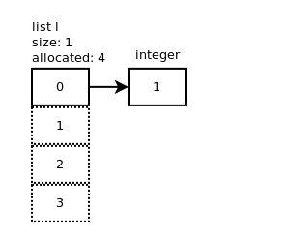
Append

Slide 8
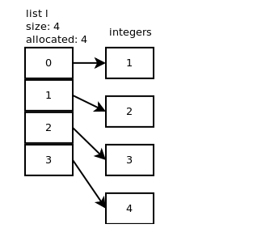
Append

Slide 9
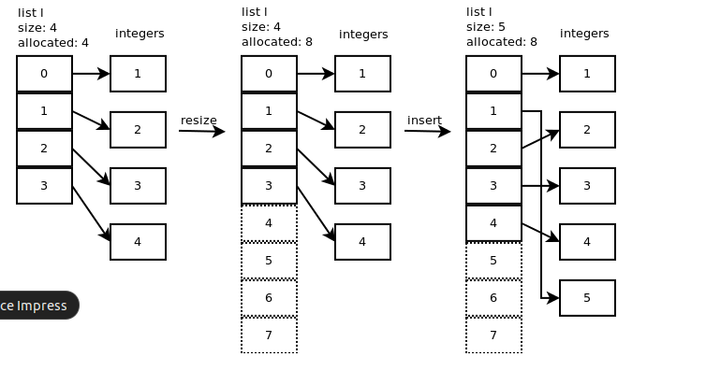
Insert

Slide 10
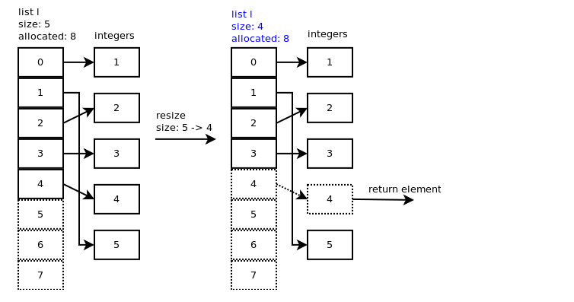
Pop

Slide 11
Tuple
Ordered
Unchangeable
Contains duplicate values
indexed

Slide 12
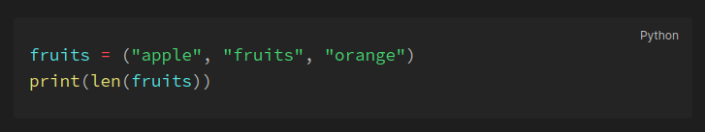
Tuple – Length
To determine how many items a tuple has, use the len() function

Slide 13
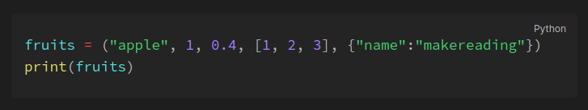
Tuple – Data Types
Tuple items can be of any data type or a combination of data types.

Slide 14
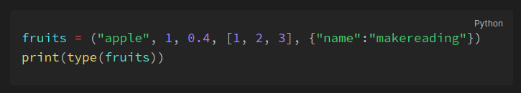
Tuple – type()
Tuple are defined as objects with the data type 'tuple'

Slide 15
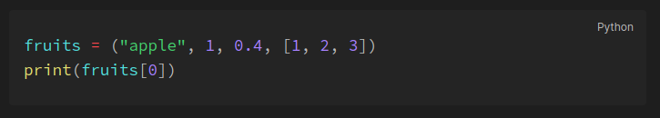
Tuple – Indexing
Tuple items are indexed.

Slide 16
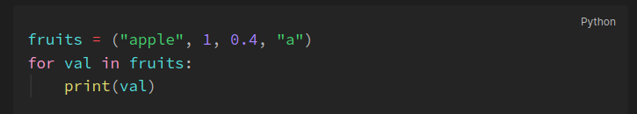
Tuple – For Loop

Slide 17
Tuple – in & not in
In – Element present in the set.
Not in – Element not present in the set.

Slide 18
Adding Values to Tuple
Adding values to a Tuple is not possible.
Workaround: We can convert the tuple to list and add values to the list, then convert back to the tuple

Slide 19
Tuple Removal – del
Del will delete the object itself.
fruits = (‘apple’, ‘orange’, ‘banana’)
del fruits
print(fruits)

Slide 20
Copy – Indirect Copy
Convert to list
Convert the list to tuple.

Slide 21
Mathematical Functions

Slide 22
    A
    B

Slide 23


Slide 24
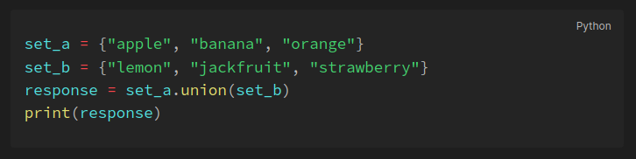
Sets - Union
Union of two sets will return all the items present in both sets (all items will be present only once). This can be done with either the | operator or the union() method.

Slide 25
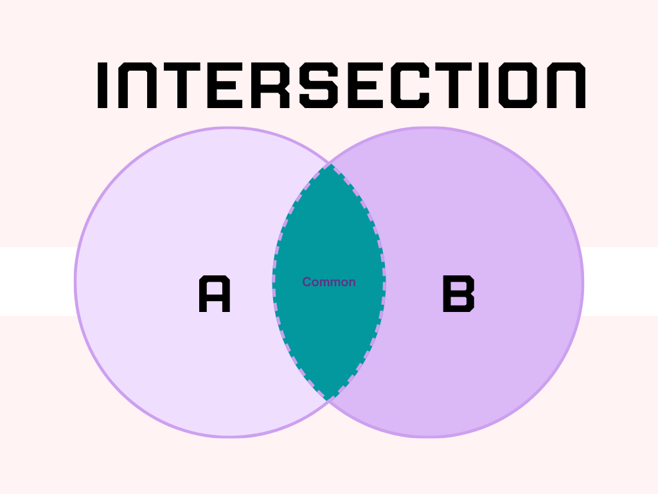

Slide 26
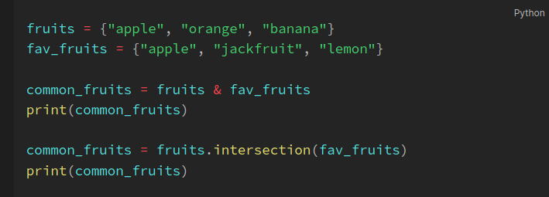
Sets - Intersection
The intersection of two sets will return only the common elements in both sets. The intersection can be done using the & operator and intersection() method.

Slide 27
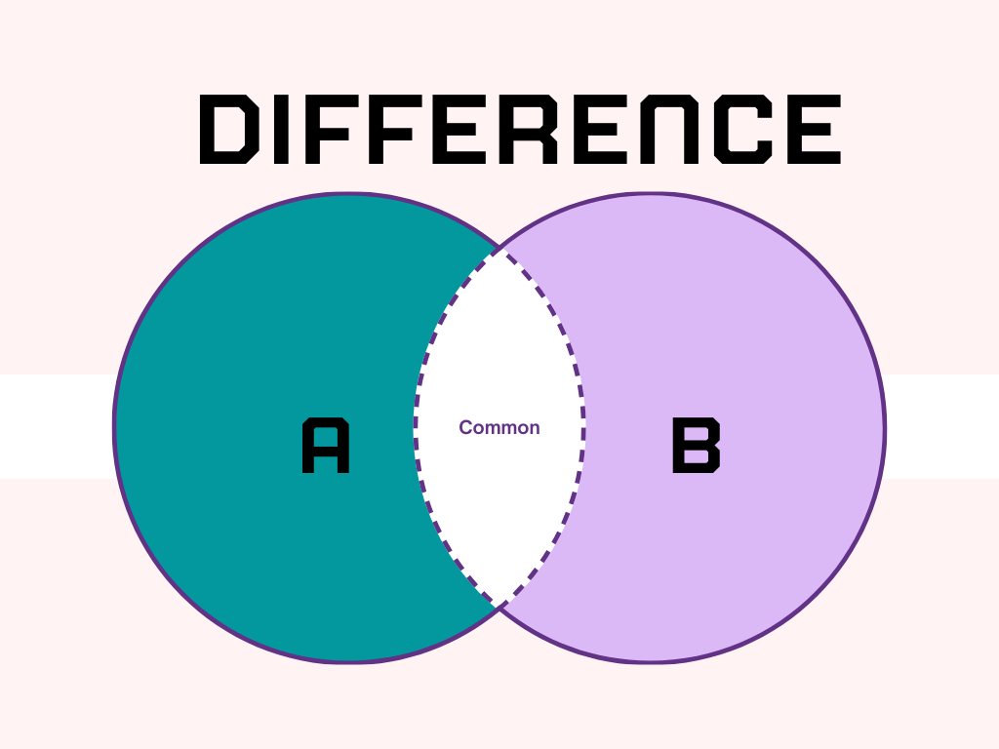

Slide 28
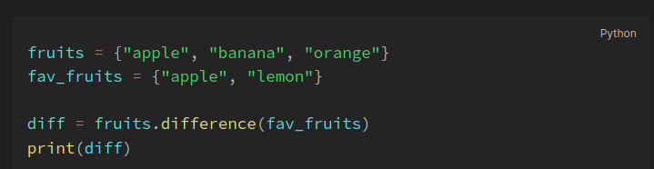
Sets - Difference
The difference operation will return the items that are present only in the first set i.e the set on which the method is called. This can be done with the help of the - operator or the difference() method.

Slide 29
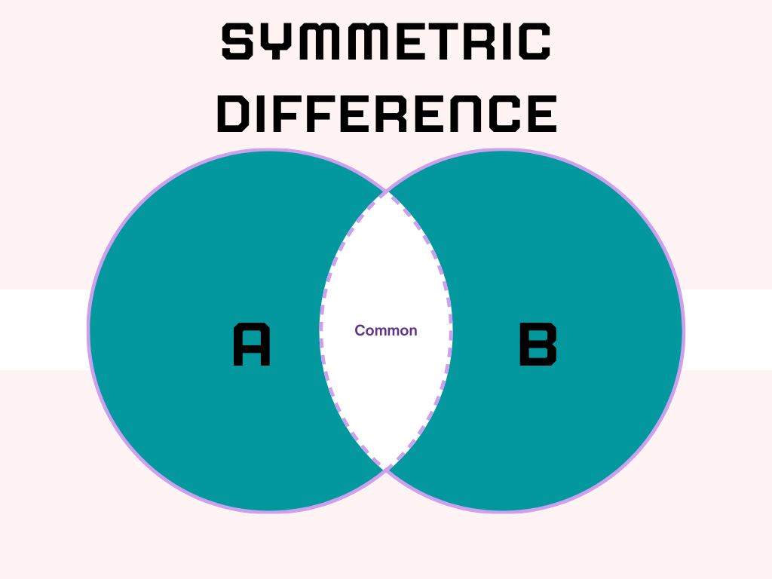

Slide 30
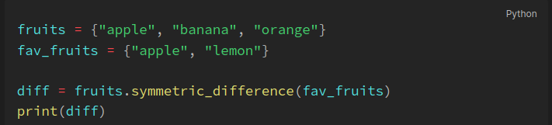
Sets - Symmetric difference
The Symmetric difference operation returns the elements that are unique in both sets. This is the opposite of the intersection. This is performed using the ^ operator or by using the symmetric_difference() method.

Slide 31
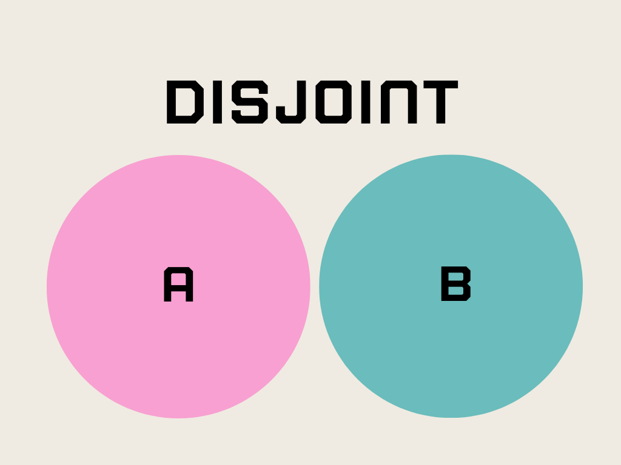

Slide 32
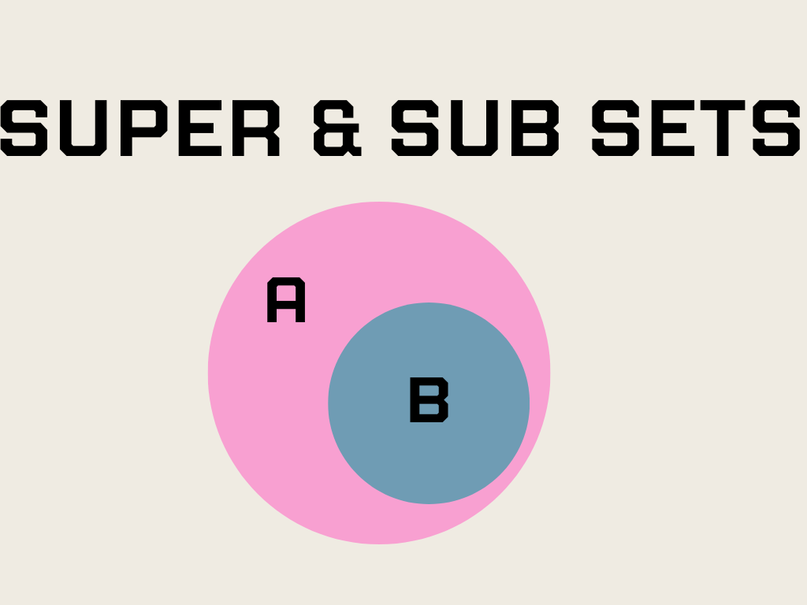

Slide 33
Q & A

